Slide 1

NPD Web Application
Project Kick-off
07 March 2022

Slide 2
Agenda
Project Overview / Scope
Solution Architecture
Functional Implementation
Work Breakdown Structure
Project Timelines
Implementation Methodology
Project Schedule
Risk & Dependencies
Key Assumptions & Constraints
Deliverables
Communication Plan
Governance Model
Escalation Procedure
Q & A

Slide 3

Project Overview / Scope
Emcure Pharmaceuticals wants to develop a web application to manage the New Product development. Emcure Group has an existing application - NPD (New Product Development) that is built using .NET technology. The current application is limited to the use of Tillomed (a group company of Emcure). The proposed application will be built in a multi-tenant architecture which will allow the employees of the other group companies within Emcure Group to access the new application with enhanced features.
The platform will have below entities and interfaces:
Administrator – Web Panel
User – Web Panel
Relevant Department User – Web Panel
Finance User – Web Panel
Management User – Web Panel

Slide 4
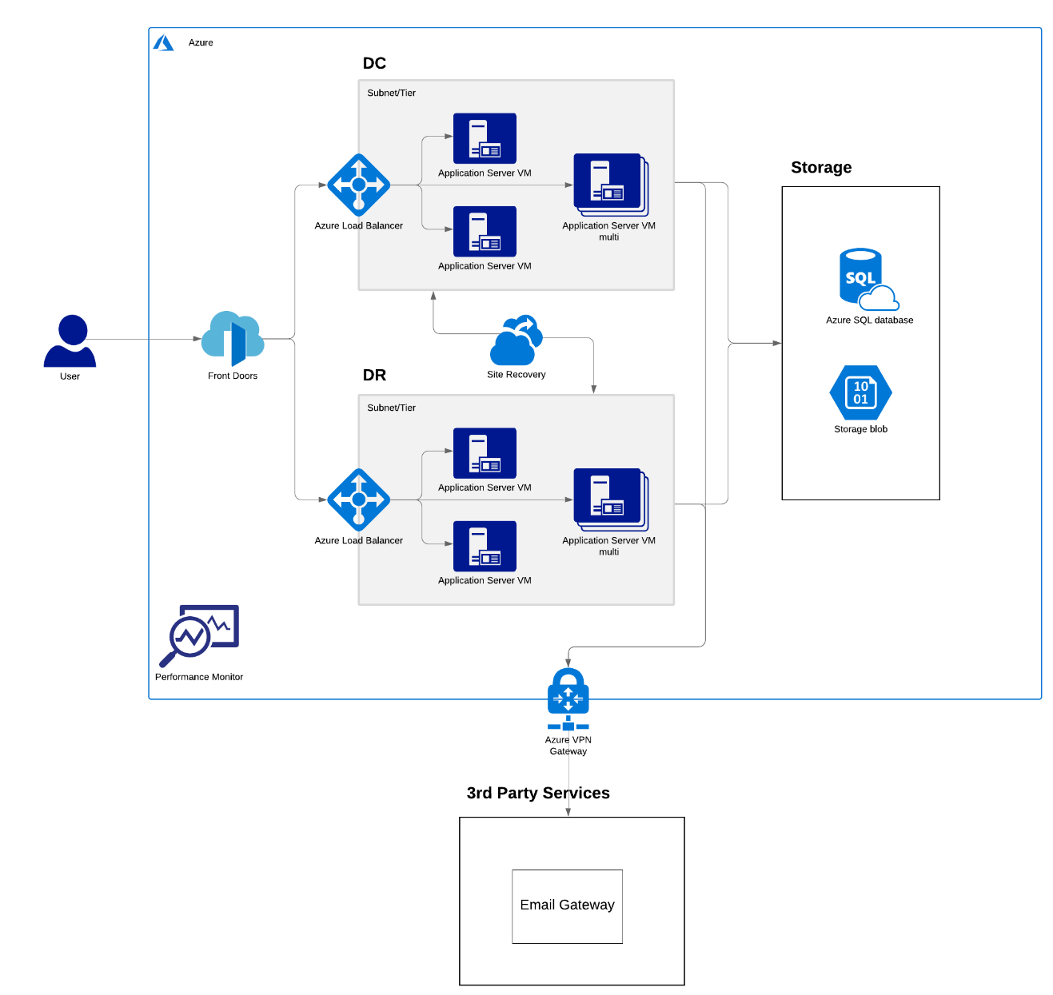
Solution Architecture
Note: It may need some revision basis
on requirement analysis (BA) phase.

Slide 5
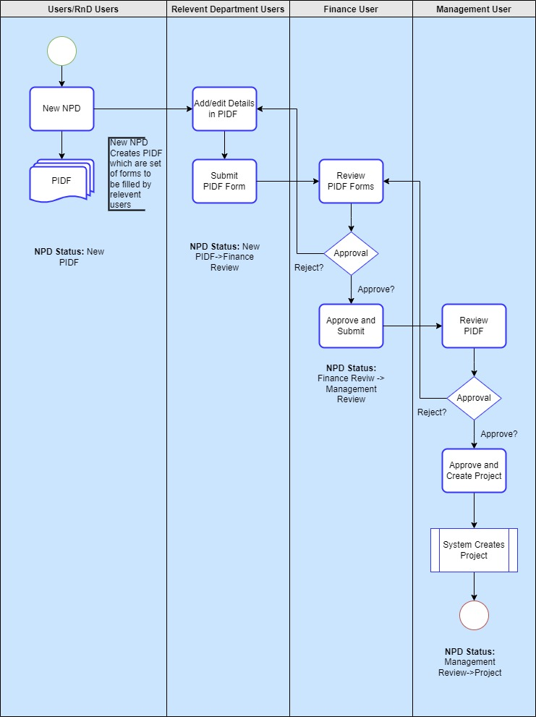
Functional Implementation

Slide 6
Work Breakdown Structure
Sr No. | Interface | Modules/Sub Modules
1 | Common Modules | Project Setup
2 | Administrators [Web] | Environment Setup and Database Design
3 | User [Web] | Design Integration
4 | Relevant Department [Web] | Role-based access control setup
5 | Finance User[Web] | Suggested - SSO based login
6 | R&D User [Web] | Login /Logout
7 | Management User [Web] | Logout
 |  | Forgot password / Password Setup
 |  | Dashboard
 |  | Roles
 |  | Master Management
 |  | Projects
 |  | NPD List
 |  | PIDF list
 |  | Dossier Management
 |  | Dossier Versioning
 |  | PIDF Forms
 |  | Management Approval
 |  | Project Creation
 |  | Gantt Chart Creation

Slide 7
Work Breakdown Structure
Sr No. | Interface | Modules/Sub Modules | Task
 |  | Projects | Project List, Project Details, Project Tasks, Gantt Chart, Archive, Delete, Archive List, Export Projects
 |  | NPD List
 |  | PIDF list
 |  | Dossier Management | Dossier List, Upload/Download dossier, Dossier Name
 |  | Dossier Versioning | Checkout Out (Edit dossier), Checkin (Publish dossier), Audit Trail, Dossier Versioning, Add comments to the dossier.
 |  | Task Master | New Task Form, Task List, Tasks Dependencies
 |  | Login | Login Form
 |  | Logout
 |  | Forgot password
 |  | Password Setup
 |  | Dashboard | Graphs and Charts
 |  | NPD | View NPD list, View NPD details, Edit NPD detail in New status
 |  | Create NPD | NPD form, NPD Approval, NPD Status
 |  | PIDF List | View PIDF list, View PIDF details
 |  | Projects | Project List, Project Details, Gantt Chart, Archive Project, Email Notification

Slide 8
Work Breakdown Structure
Sr No. | Interface | Modules/Sub Modules | Task
 |  | Tasks | View Task list, Edit Tasks
 |  | Gantt Chart | View Gantt Chart, Edit Gantt Chart Tasks
 |  | Dossier Management | Dossier List, Upload/Download dossier, Dossier Name creation
 |  | Dossier Versioning | Checkout Out (Edit dossier), Check-in (Publish dossier), Audit Trail, Dossier Versioning, Add comments to the dossier.
 |  | Login | Login Form
 |  | Logout
 |  | Forgot password
 |  | NPD list | View NPD details
 |  | PIDF | View PIDF details, Edit PIDF form, Submit PIDF, PIDF Status, PIDF Comments
 |  | Login | Login Form
 |  | Logout
 |  | Forgot password
 |  | Dashboard | Graphs and Charts
 |  | NPD List | View NPD details
 |  | PIDF | View PIDF List, View PIDF details, PIDF Status, PIDF Comments, Approve/Reject PIDF

Slide 9
Work Breakdown Structure
Sr No. | Interface | Modules/Sub Modules | Task
 |  | Login | Login Form
 |  | Logout
 |  | Forgot password
 |  | Dashboard | Graphs and Charts
 |  | Create NPD | NPD form, NPD Approval, NPD Status
 |  | NPD List | View NPD details
 |  | PIDF List | View PIDF details, PIDF Status, PIDF Comments
 |  | Projects | Project List, Project Details, Gantt Chart, Archive Project, Email Notification
 |  | Tasks | View Task list, Edit Tasks
 |  | Dossier Management | Dossier List, Upload/Download dossier, Dossier Name
 |  | Dossier Versioning | Checkout Out (Edit dossier), Check-in (Publish dossier), Audit Trail, Dossier Versioning, Add comments to the dossier.
 |  | Login | Login Form
 |  | Logout
 |  | Dashboard
 |  | Forgot password
 |  | NPD List | View NPD details
 |  | PIDF List | View PIDF details, PIDF Status, PIDF Comments

Slide 10
Work Breakdown Structure
Sr No. | Interface | Modules/Sub Modules | Task
 |  | Management Approval
 |  | Project Creation | Trigger project creation with task after approval
 |  | Gantt Chart Creation | Create Gantt chart from task master
 |  | Projects | Project List, Project Details, Gantt Chart, Archive Project, Email Notification
 |  | Tasks | View Task list, Edit Tasks
 |  | Dossier Management | Dossier List, Upload/Download dossier, Dossier Name creation
 |  | Dossier Versioning | Checkout Out (Edit dossier), Check-in (Publish dossier), Audit Trail, Dossier Versioning, Add comments to the dossier.

Slide 11
Project Timelines
Activities | Week 1 | Week 2 | Week 3 | Week 4 | Week 5 | Week 6 | Week 7 | Week 8 | Week 9 | Week 10 | Week 11 | Week 12 | Week 13 | Week 14 | Week 15 | Week 16 | Week 17 | Week 18 | Week 19 | Week 20 | Week 21 | Week 22 | Week 23 | Week 24
Requirement Analysis
Solution Architecture
Database Designing
HTML Development
Dot NET Development
Testing
DevOps
UAT Period
UAT Sign-off
Production Deployment
Training

Slide 12
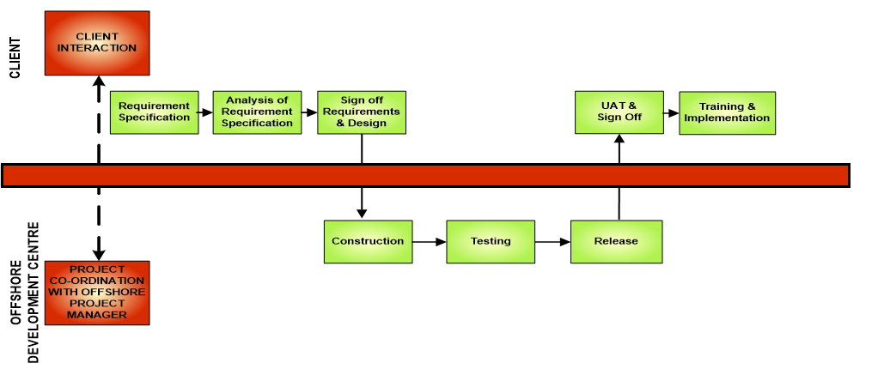
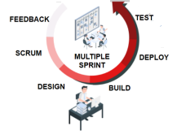
Implementation Methodology

Slide 13
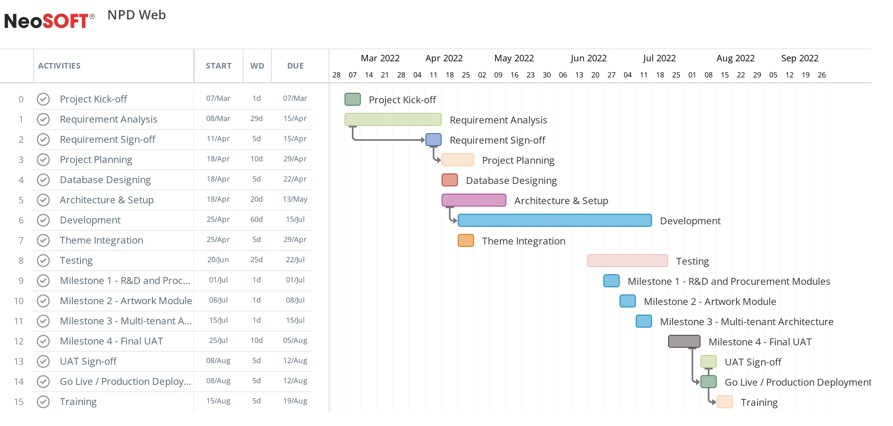
Project Schedule
Note: This is a tentative schedule. Once the requirements are baselined, the actual project schedule and dates shall be submitted.

Slide 14
Deliverables
Requirement Gathering
SRS
Wireframes
Design
Theme Finalization & Integration
Project Execution
Project Plan
Project Monitoring Artifacts
Risk Analysis
Development / Implementation
Application Build
QA
Test Plan
Test Cases / Report
UAT
Training
User Manual

Slide 15
Risks and Dependencies
 | Risk | Impact | Severity | Mitigation strategy | Owner
1 | Availability of servers/ licenses on time for initiating project | Project Initiating | High | Necessary environment to be available during the implementation phase | Emcure
2 | Scope creep | Overall Project | High | Changes in scope due to requirements gathering phase will be re-estimated and in case extra effort are encountered, NeoSOFT will issue a change request | Emcure, NeoSOFT
3 | Delays in getting approvals | Overall Project | High | Approval committee calendar will be set to book the timing according to the milestones | Emcure
4 | Miscommunications/ delay in clarifications | Overall Project | High | Identify SPOC for queries clarifications. To have communication matrix to ensure all the queries are properly clarified on time. | Emcure, NeoSOFT
5 | New additional requirements in the scope of work | Overall Project | High | If the new scope requires additional cost and time, then escalation to be done. After escalation, all parties work towards achieving timely decision and mitigation to follow decision. | Emcure
6 | Lack of knowledge in the existing environment | Assessment Time | High | To have a proper KT Process and the availability of a SPOC for KT. | Emcure

Slide 16
Key Assumptions and Constraints
Exact requirements for the solution hierarchy shall be gathered in the Requirements Gathering phase
Changes in scope due to requirements gathering phase shall be re-estimated and in case extra effort are encountered, NeoSOFT system shall issue a change request
Web Applications will support the English language only.
We are considering 3rd party theme-based design for the web application.
All the 3rd Party APIs those would be integrated with the proposed system will be finalized before the start of the development. (Development time will be calculated based on the number of 3rd Party APIs and complexity of the same). Cost to be paid by the client for integrations.
The email gateway will be finalized during the requirements (BA) phase.
Responsive designs shall be implemented only if the purchased theme supports the same.
Azure will be used only as hosting environment and no other Azure services to be utilized as such.
Note: Detailed assumptions, constraints and standard terms & conditions are available in the approved proposal

Slide 17
Communication Plan
Information | Frequency | Responsibility | Audience | Medium
Status Meetings | Weekly | PM | Key Stakeholders ( Emcure and NeoSOFT) | Email, Phone/Teams/Skype
Steering Committee Meeting | upon each Milestone or as and when required | PM | Key Stakeholders, Steering Committee | Email, Phone/ Teams/Skype
Approvals | As and when required | Emcure PM | Emcure stake holders | Emails
Sprint review Meetings | Biweekly (Every 2 Weeks) | PM | Key Stakeholders ( Emcure and NeoSOFT) | Phone/Teams/Skype
Standup Meeting* | Every day (Till the discovery phase is completed) | Emcure + NeoSOFT (PM/ BA) | Key Stakeholders ( Emcure and NeoSOFT) | Phone/Teams/Skype
Note: During the requirement gathering phase, we need the availability of all the key stakeholders from each
department atleast of couple of hours everyday. Will be sharing the Requirements gathering plan separately.

Slide 18
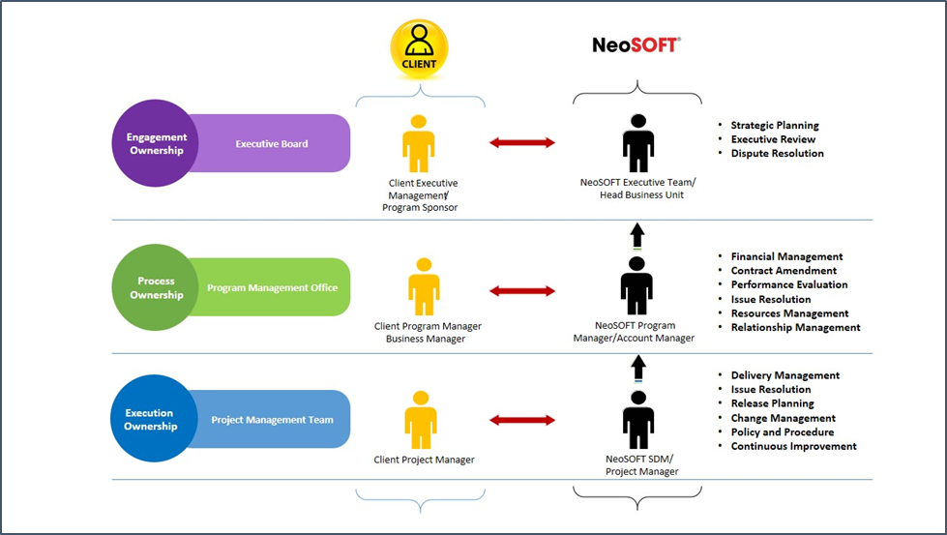
Governance Model

Slide 19
Escalation Procedure
Sr.No | Description | Emcure Contact | NeoSoft Contact | Name | Email
1 | Sales & Account Management | Procurement Manager | Business Development Manager | Saumil Shah | saumil.shah@neosofttech.com
2 | Requirement Gathering | Lead Business Analyst | Lead Business Analyst | Khevna Shah | khevna.shah@neosofttech.com
3 | Day-to-day issue resolution | Project Manager | Project Manager | Nilesh Jain | nilesh.jain@neosofttech.com
4 | Critical escalation when issues may impact business performance | Operations Head | VP – Delivery | Karthik N | karthik.natarajan@neosofttech.com
5 | Extended Support | Operations Head | VP – Delivery / Solutions / Technology | Santhosh K R | santhosh.r@neosofttech.com

Slide 20


Slide 21
THANK
YOU

